Slide 1
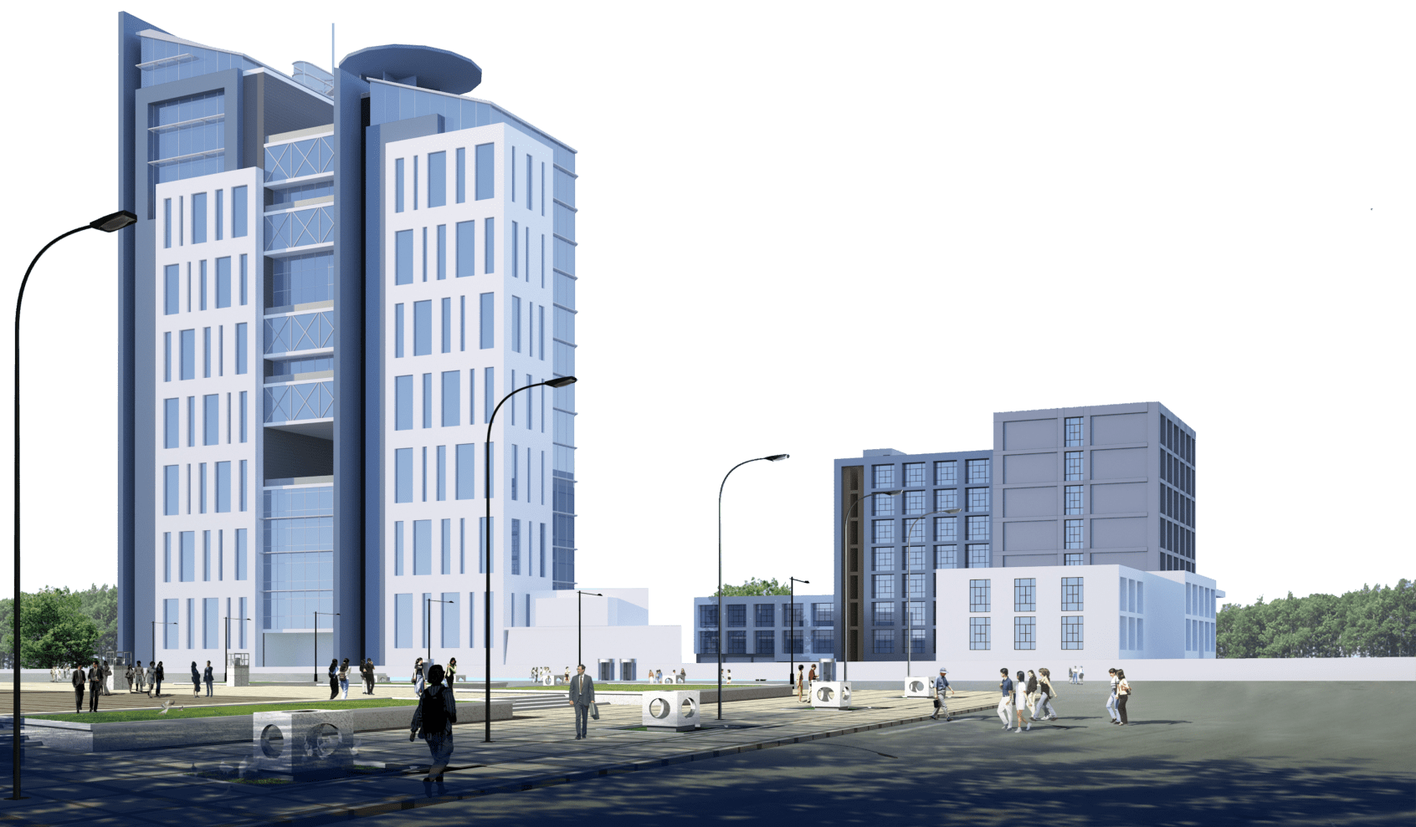
Project Kick-off Meeting for Implementation of Campus Management Application at World Skill Center (WSC) by Sustainable Outreach And Universal Leadership (SOUL) Limited
18-01-2023 & 5:00 PM

Slide 2
Agenda
Project Details
Scope of the Project
Product Modules
Key Integrations
Project Assumption
Engagement Model
Execution Methodology
Project Plan and Milestones
Responsibility Assignment Matrix - RACI
Key Team members- SOUL
Risks
Dependencies
Governance Model
Escalation Matrix
Change Management Process
Next Steps

Slide 3
Project Details
Project Name | Campus Management Application for World Skill Center (WSC)
Package Number | PKG 0111
Tender Number | OSDA/WSC/Goods/M7-2022
Planned Start Date | 18-Jan-2023
Contractual Value | 1,54,58,000 INR
Duration | 5 years (1 year (Implementation) + 1 year warranty + 3 years support)

Slide 4
Scope of the Project
Project Scope | Requirement
 | Design
 | Development
 | Configuration
 | Deployment
Project Acceptance Criteria | Submission of SRS document & Design Document
 | Implementation of System and handing over to the users for user acceptance test
 | End user training

Slide 5








Product Modules
1.Students Management Modules
Master Data (Students Profile, Personal Information, Contact Details, Academic Details)
Issue of Identity Card 
Hostel Management,Scholarships,Rewards and achievements
Students Exams records of all 6 semesters
Students Grievance System
Messaging System
2.Academic System
Courses and Subjects, Timetable preparation and management,Class occurrence monitoring
Faculty Workload / Lesson Plan  ▪
Class Attendance of students (Face recognition or any other automated mode)
Results Analysis after declaration of results by WSC
Students Feedback mechanism on quality of teaching learning, Internship, Training, Apprentice
Re-Admission Process after discontinuing in studies
Students Back paper tracking etc.
3.Procurement & Inventory Management
Purchase Requisitions
Stores & Inventory Management
Receipt, verification & acceptance of goods
Stock entry,Issue of goods to sections / departments
Invoice entry transfer to accounts/Directorate
Fixed assets Register
Sectional Indent Register,Sectional Stock Register,Scraps / Obsolete Items management
4.Human Resources Management System
Sanctioned Post Management (Recruitment, Promotions, Transfers,Retirements, etc.)
Staff Profile including Educational qualification, Training, achievements etc.)
Annual Increments
Annual Internal Performance Review System
Performance Management System
Disciplinary cases,Court cases monitoring
5.Finance and Accounting System
Receipt and Payment entries, etc.
Direct Transfer of caution money to students’ accounts.
Demand Register
Caution Money Register
Bank Reconciliation Statement.
Generation of Cash Book (PL)
Grants-in-Aid Register
Paid Voucher Register
Advances Register,Auditing and Tracking of pendency of Audit Paras etc
6.Training and Placement
Master data on potential Employers
Campus Interview Scheduling and Mapping
Students Database and eligible list
Messaging to students
Seminar / Conferences / Internships
Registrations, Participation, Results, Placements
Tracer study for 3 years etc.
Ability to integrate with the state portal for placement management under
Skill Development & Technical education Department
7.Infrastructure
Master data for Land and Buildings.
Allocation of Quarters
Database on ongoing Projects / Works
Estimate preparation monitoring for new Project / Work
Project Plan Monitoring
Security Services, support services monitoring
Maintenance and AMC

Slide 6



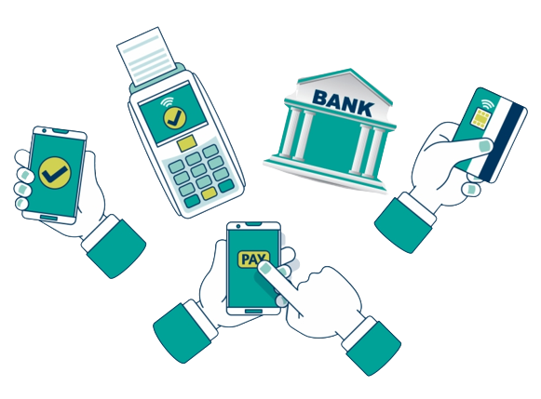




Key Integrations
Library Management
Learning Management
CMS system for managing Alumni Portal
Payment Gateway
Website
Digital Notice Board
Communication channels SMS / Whatsapp
(ERP Integration with applications part of organizations within Government of Odisha ecosystem which are associated with WSC)
Biometric System / RFID system
*Note :
API for all Integration would be available before the start of development phase

Slide 7

Project Assumption
Changes requested after requirement document is signed off will be considered as a Change Request (CR)
Relevant WSC Stakeholders need to be available throughout the project execution phase as and when required
Post deliverable release (documents) , WSC stakeholders will either accept or request further changes to it. If SOUL, does not receive any response (within 7 days), the deliverable is deemed accepted
End users must be available to do the UAT during the scheduled time frame
Infrastructure required to deploy the proposed solution must be made available by WSC team

Slide 8
Engagement Model
SOUL
WSC
SOUL
WSC
PM,TL
SME’s
Management
Management
Role | Abbreviation
Team Lead | TL
Business Analyst | BA
System Administrator | SA
Project Manager | PM
Development Team | DT
SOUL
WSC
User Training
Project Kick-off
SOUL
WSC
TL, BA
End Users
UAT and
Data loading
System Requirement
& GAP Analysis
BA, PM, TL
SME’s
SOUL
WSC
System Implem-
entation
SOUL
WSC
System design
SOUL
WSC
Business Analyst,
Team Lead
WSC
Stakeholders
Business Analyst, Project Manager,
Team Lead
WSC
Stakeholders
SA, PM, TL
Team
TL, DT
Team
System Integration Testing
Development & configuration
SOUL
WSC
SOUL
WSC
Team Lead,
Development Team
BA, TL
Team
DT, SA
Team

Slide 9
Execution Methodology
Kick off Planning
Requirement Gathering
Design
Development & Customization
Build & Test
Implementation & Go-Live
Training
Signing of Contract
Identify Stakeholders
User goes through the base system
Requirement study and gap analysis
Requirement sign off
High Level Design
Design Prototype
Design sign off
Development of the different modules as per the Requirements & design
System Integration testing
User acceptance testing
Close Defects reported
Sign off of the Defect resolution
UAT Sign off
Prepare for Production Migration
Deployment on the production server
Data Migration
Fix-production issues
Sign-off Fixes
Support & Maintenance
User training & Knowledge transfer
Deliverables: SRS Document
Deliverables: High Level Design, Prototype
Deliverables:
Working System
Deliverables:
Test Plan
Deliverables:
Production System
Deliverables:
Training Manual

Slide 10

Project Plan and Milestones
Phases | 6 Months |  |  |  |  |  | 6 Months |  |  |  |  |  | 15 Days
System Requirement Study and Gap Analysis
System Design
Development & Configuration
System Integration Testing
System Implementation
User Acceptance Test and Data Loading
System GO-Live
Staff Training
T(0) + 2 months
T(0) + 4 months
T(0) + 6 months
T(0) + 6 months
T(180) + 5 months
T(180) + 6 months
T(180) + 6 months
Project Kick-Off - T(0)
Detailed project plan in a Excel format will be shared separately
The timelines mentioned here are indicative and will change as the discussion progresses between SOUL and WSC from Requirement Study phase
WSC Stakeholders need to be available throughout the project execution phase as and when required and will sign off the requirements in a timely manner during the planned time frame

Slide 11
Responsibility Assignment Matrix - RACI
Role | Project Manger | Delivery Team | WSC SME’s | WSC IT
Project Activities
Project Planning | A | R | C
Business Requirement Identification | A | R | R
High Level Design (HLD) | I | R/A | C
Development Configuration | A | R | I
System Integration Testing | A | R | C
UAT | C | C | R/A
Infrastructure Readiness | A | R | C | R
Application Deployment | A | R | C/I | C/I
User Training | A | R | R
Review of the Deliverables | R/A | C | R/A
Coordination with external teams for Integration | C | I | R/A
Data Loading | C | C | R/A | R/A
R - Responsible
A - Accountable
C - Consulted
I - Informed

Slide 12
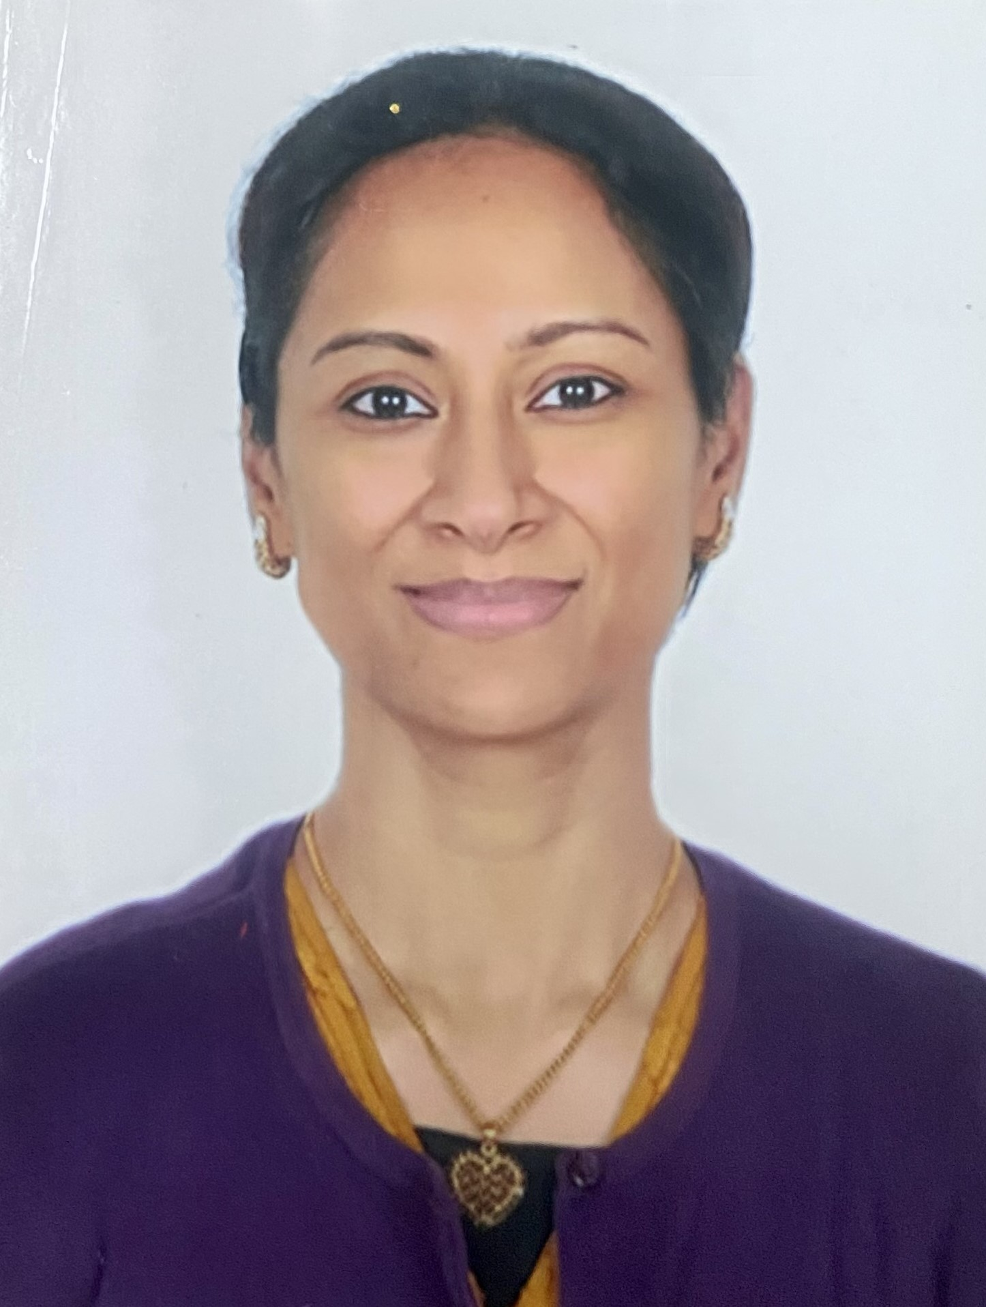
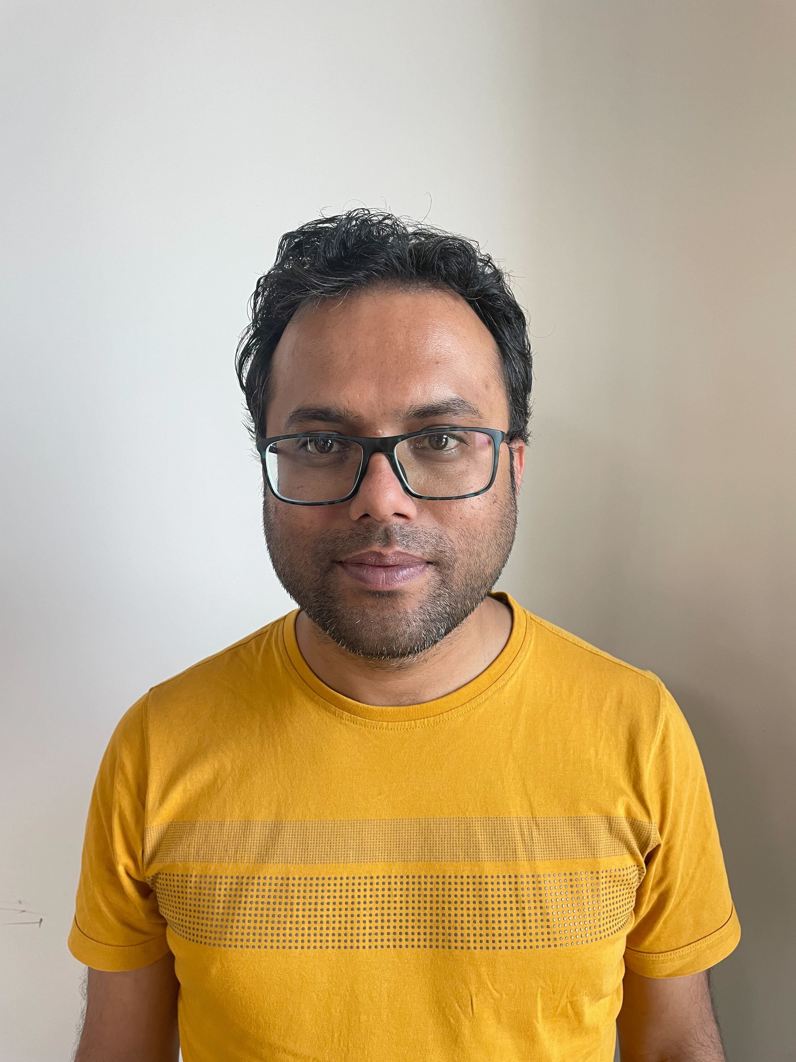
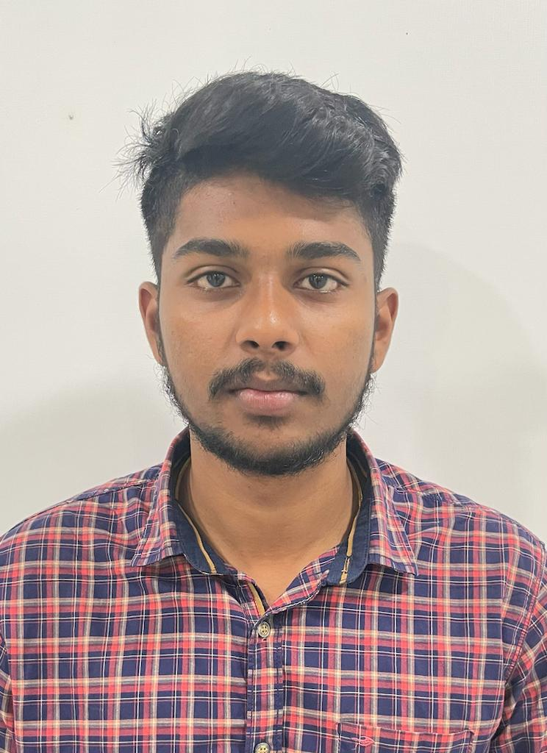
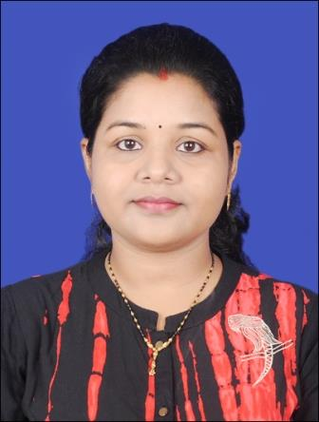

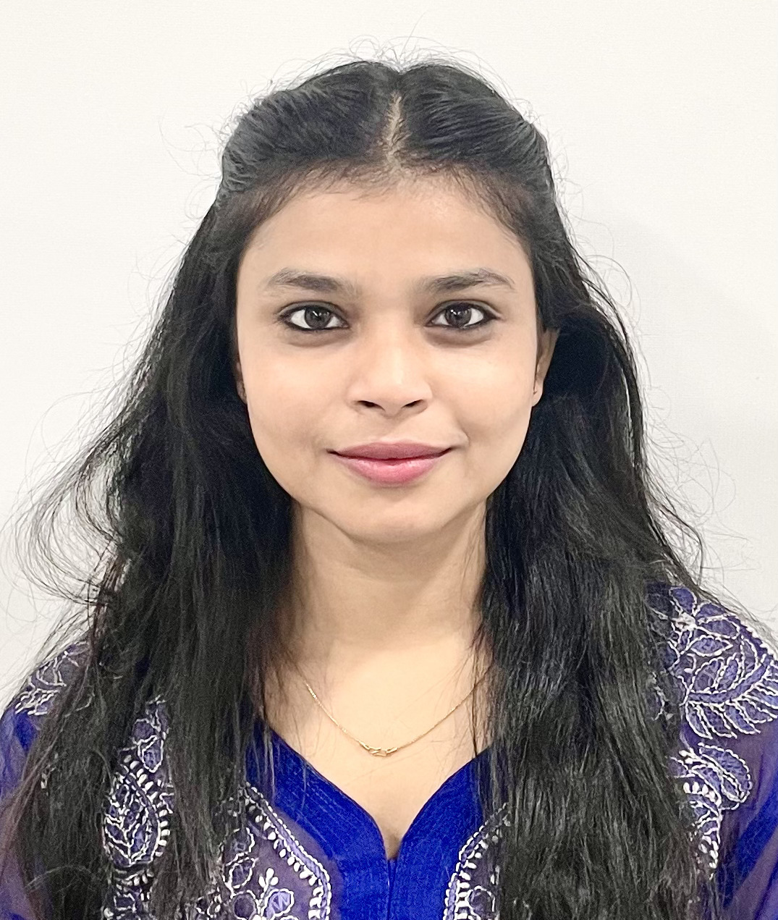
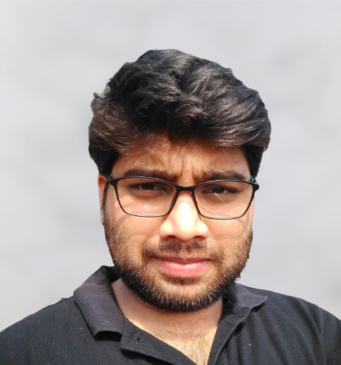
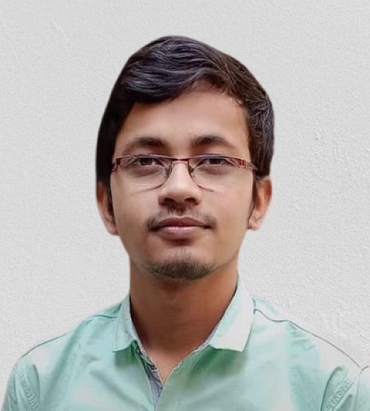
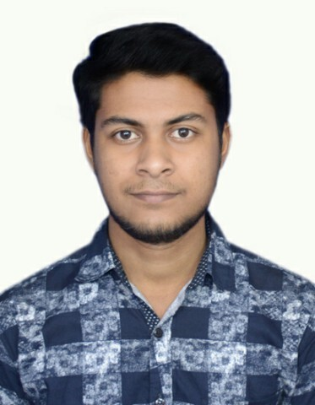
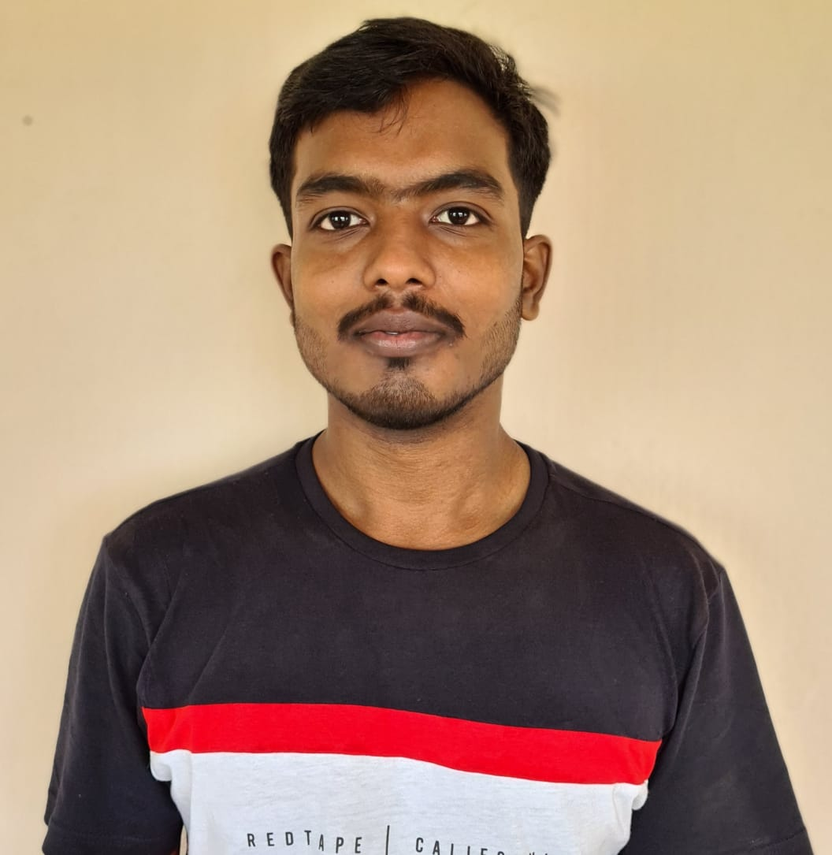


Key Team Members - SOUL
Sharmistha Panda (Project Manager)
sharmistha.panda@soulunileaders.com
9845047803
Abhishek Adhikari (Team Lead)
abhishek.adhikari@soulunileaders.com
8895552654
SK Tousiff Taj (Business Analyst)
tousiff.taj@soulunileaders.com
Rupali Bhatta (Developer)
rupali.bhatta@soulunileaders.com
Priytesh Shah (Business Analyst)
priytesh.shah@soulunileaders.com
Shuti Kumari (Developer)
shruti.kumari@soulunileaders.com
Sivashreet Maharana (Team Lead)
sivashreet.maharana@soulunileaders.com
Nehal Kumari (Developer) nehal.kumar@soulunileaders.com
Subhajit Saha (Developer)
subhajit.saha@soulunileaders.com
Rajendra Kumar Bera (Developer)
rajendra.bera@soulunileaders.com
Sharthak Kumar Rath (Developer)
sarthak.srath@soulunileaders.com
Rojalin Biswal (System Administrator)
rojalin.biswal@soulunileaders.com

Slide 13
Risks
Risk | Probability | Criticality | Mitigation
Critical Resource of the project exits from the organization, project plan / schedule will be affected | Medium | Medium | SOUL team needs to plan backup resources and provide adequate Knowledge Transfer
Inconsistent requirements will have conflicts in design | Medium | High | Stakeholders should discuss to get the broad outline of ERP software
If there is a delay in sharing of requirements, consecutive project phases will be impacted | High | High | Key stakeholders should have knowledge on ERP functionality
Unavailability of hardware resources (Server) will delay deployment process | Medium | High | Server and other Hardware resources needs to be handed over before the Testing phase
Unavailability of API for third party integration will delay application development | Medium | High | Project timeline schedule need to be shared with third parties to avoid the delay in Integration
Frequent or unexpected expansion of the project scope will impact on Project Plan | High | High | Change control board should be empowered so that change would move across phases post implementation
If there is a change / unavailability of WSC SME / SPOC, project schedule will get impacted | Medium | Medium | WSC leadership team to ensure proper KT with the new team member and inform Feast team in advance
Data template not shared with WSC as per scheduled plan then, delivery will be impacted | Low | Medium | Data template should be provided by SOUL to WSC on time
End Users of the application unavailable for the training to be provided by SOUL | Medium | High | WSC Stakeholders should share the training plan prior with end users

Slide 14
Dependencies
Availability of the relevant WSC Stakeholders throughout the project execution phase is crucial hence, they should be available as and when required
WSC Stakeholders / End Users will need access to ERP solution for UAT phase
WSC should ensure hardware resources (Servers) available on time for application deployment
WSC team need to ensure the data they provide is accurate
WSC and SOUL should coordinate for reviews as per scheduled plan to track the progress of project execution

Slide 15
Governance Model
Steering Committee
Overall project governance , direction & management oversight
Escalation point as needed
Steering Committee
WSC
Level 3
Project Management Committee
Performance & management of project
Ensure on time delivery of the system
Address the issues & risks raised by the Working Committee
Delivery
Manager
WSC
Level 2
Working Committee
Development & delivery of the requirements
Addresses tactical and operational issues
Project Manager
WSC Project Manager
Meeting | Frequency | Governance Bodies | Purpose
Working level meeting | Weekly | Working Committee | Review progress against key milestones with Project team, leads and SOUL project manager Discuss concern areas or operational issues
Project Status Update Meeting | Fortnightly | Project Management Committee Working Committee | Monthly performance review Discuss outstanding and new issues Forecast of activities
Steering Committee Meeting | Monthly | Steering Committee Project Management Committee Working Committee | Project performance review Upcoming milestones and plans Issues requiring intervention

Slide 16
Escalation Matrix
Escalation Level | WSC | SOUL
Level 1 |  | Team Lead
Level 2 |  | Project Manager
Level 3 |  | Delivery Manager
Level 4 |  | Steering Committee

Slide 17




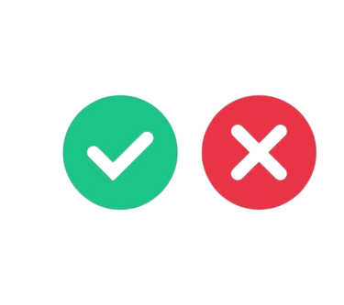
Change Management Process
Review
Assessment of the
implementation results
Request for Change
Change in the product feature which was not defined during requirement analysis phase
Implement Change
Development team will initiate the change implementation
Impact Analysis and Estimation
Development team will evaluate the implications of the change and estimate the additional effort and cost required to implement the change based on the evaluation.
Approve/ Deny
Post evaluation, Change Request Board will approve or deny implementation of change

Slide 18
Next steps
Action Item | Responsibility | Target Date | Status | Dependencies
Project Kick-Off | SOUL - WSC | 18-Jan-23 |  | WSC stakeholders availability
Environment Availability | WSC | To be updated by WSC | Not Started | WSC to provide server
Base version Availability | SOUL |  | Not Started | Environment Availability
Start of System Requirement study and Gap analysis | SOUL - WSC | Post Project Kick-Off meeting | Not Started | WSC team availability

Slide 19
Thank You

